Slide 1





Pulse
Social Media and Marketing Multi- Agents Platform
Team Members:
Supervisor:
Abdelrahman Elattar
Dr.Mohamed Maher
Abdelrahman Omar
Hager Saad
Rana Mahmoud
Submission Date: 2025-11-21
CSAI School

Slide 2

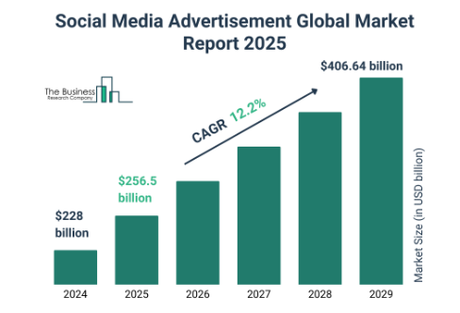
The Problem Statement
Problem Statement
Managing a multi-platform social media ecosystem manually results in operational bottlenecks, inconsistent brand messaging, and missed engagement opportunities due to the lack of unified, real-time oversight
Impact
Operational Inefficiency: Marketing teams waste 60% of their time on repetitive scheduling rather than strategy.
Brand Dilution: Fragmented execution across channels damages brand integrity and reduces customer trust.
Revenue Loss: Slow response times to customer inquiries lead to lower conversion rates and customer churn.
Motivation
In the age of 24/7 digital interaction, businesses need an "always-on" heartbeat.
Current tools are passive "co-pilots"; there is an urgent need for an autonomous agentic workflow
that can monitor, reason, and execute marketing tasks in real-time to maintain a competitive edge.
Market Size Value In 2025 $256.5 billion
Revenue Forecast In 2034 $406.64 billion

Slide 3


The Proposed Solution
Proposed Solution Overview
Pulse is an autonomous, Multi-Agent System (MAS) that orchestrates the entire social media lifecycle. Unlike standard schedulers, Pulse employs four specialized AI agents to autonomously plan strategies, generate content, engage customers, and analyze performance in a closed feedback loop.
Key Features
Multi-Agent Architecture: Collaborative agents (Strategist, Analyst, Customer Support, Content Engine) that delegate tasks and share context.
"Business DNA" Extraction: The system ingests and encodes the brand’s core assets like logos, fonts, color palettes, and tone of voice into a semantic knowledge base. This ensures every autonomously generated post is visually and tonally consistent with the brand identity.
Closed-Loop Optimization: The Performance Analyst Agent autonomously retrains the Content Engine based on real-time analytics (e.g., "Stop using emojis in LinkedIn posts, they lower CTR").
Real-Time Engagement: NLP-driven instant responses to DMs and comments, maintaining the brand's heartbeat 24/7.

Slide 4
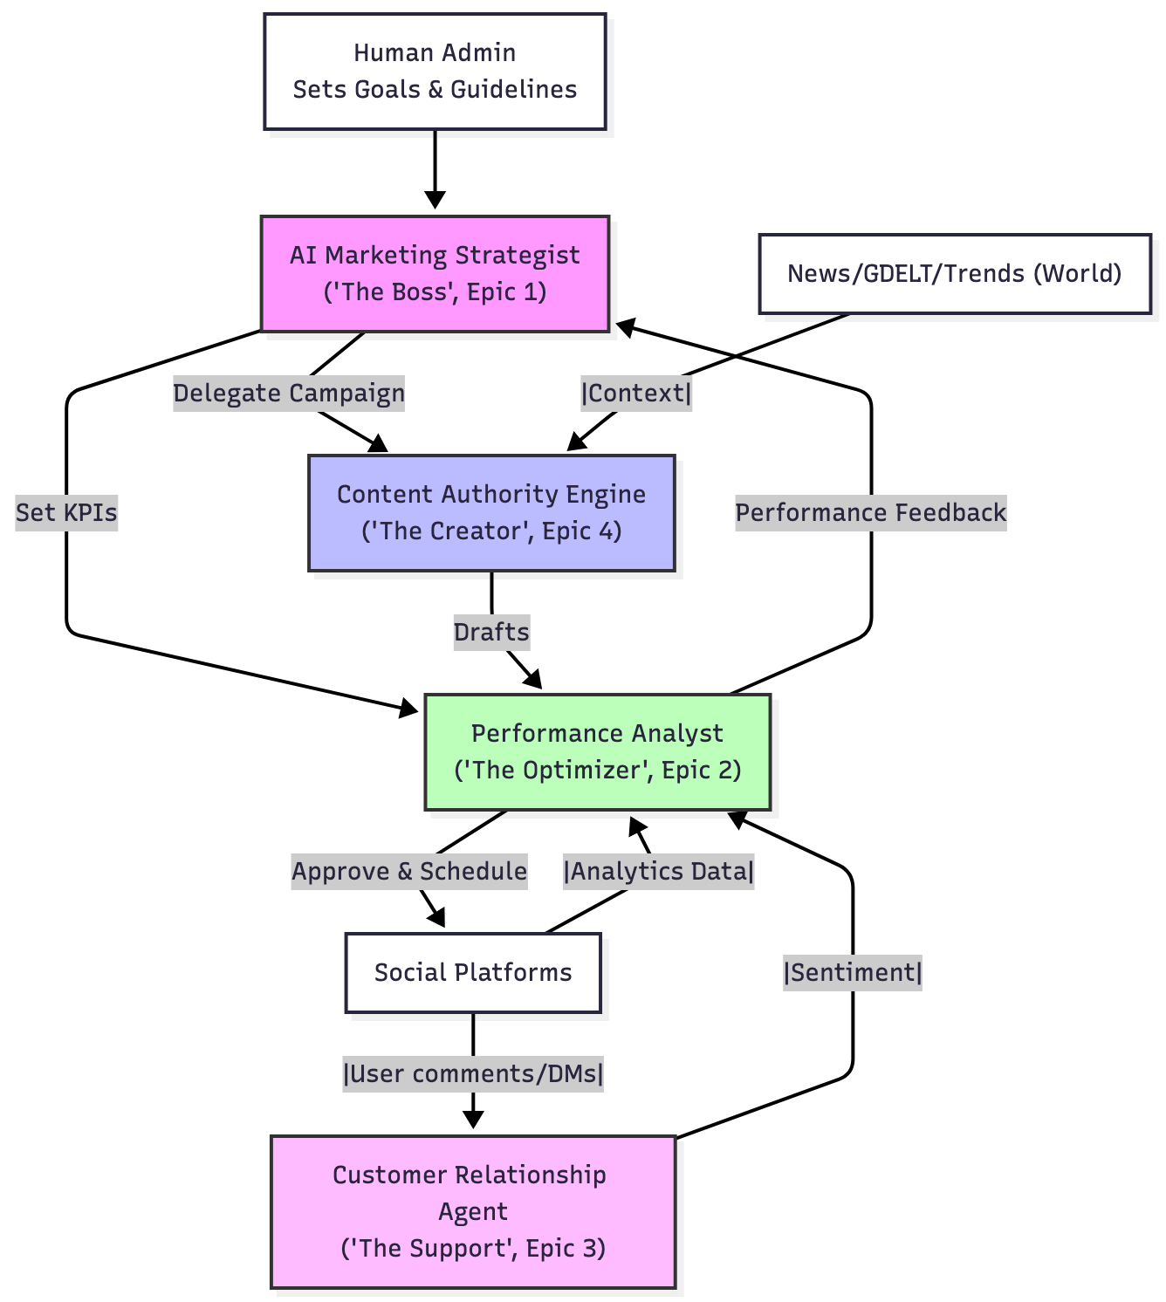
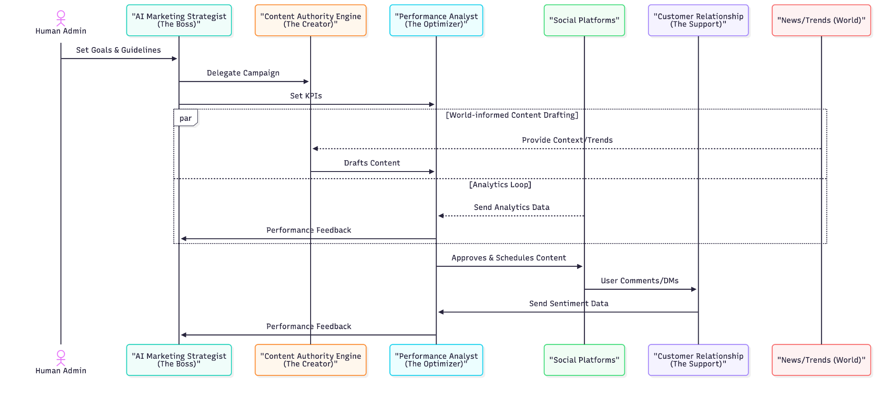
The Proposed Solution - Diagrams

Slide 5
Target Audience
Primary User Persona
The "Overwhelmed" Chief Marketing Officer (CMO | CEO) of an SME or a scaling E-commerce Brand.
User Characteristics
Context: Manages multiple channels (Meta, X, TikTok) with a small or non-existent team.
Goals: Wants to establish "Thought Leadership" and drive revenue without spending hours on manual execution.
Pain Point: Struggles to maintain a consistent "Big Brand" presence due to resource limitations.
The Need
This audience needs autonomy, not just automation. They do not need another tool that waits for instructions; they need a system that can take a high-level goal (e.g., "Increase Q4 sales") and autonomously execute the necessary content strategy, ensuring visual ("Business DNA") and tonal consistency without constant human hand-holding.

Slide 6






Competitive Analysis
Feature
Pulse (Our Solution)
Waxwing AI
Make (formerly Integromat)
Core Technology
Multi-Agent Cognitive System (Strategy + Execution)
AI Strategy Planning & Project Management
Workflow Automation (iPaaS) / Logic flows
User Experience
Goal-Oriented: "Make me famous" -> System figures out the "How"
Task-Oriented: Guided planning and breakdowns
Builder-Oriented: Drag-and-drop logic construction
Integration Capability
Deep Context: Agents share memory & "Business DNA" across apps
Medium: Connects for planning, not deep execution
High: Connects APIs but lacks semantic understanding
Cost Structure
Value-Based: Reduces headcount cost
SaaS Subscription: Planning tool pricing
Usage-Based: Per operation/action
Key Differentiators
Business DNA Integration: Unlike competitors that generate generic content, Pulse anchors all output to the extracted visual and tonal DNA of the brand (fonts, colors, voice), ensuring authentic engagement.
Autonomous Closed-Loop: Make requires humans to build logic flows; Waxwing requires humans to execute the plan. Pulse is the only solution where the Analyst Agent can autonomously instruct the Content Agent to change strategy based on data, without human intervention.
Active Listening: Pulse doesn't just post; it listens (via Reddit, ..etc.) and reacts to trends autonomously.

Slide 7

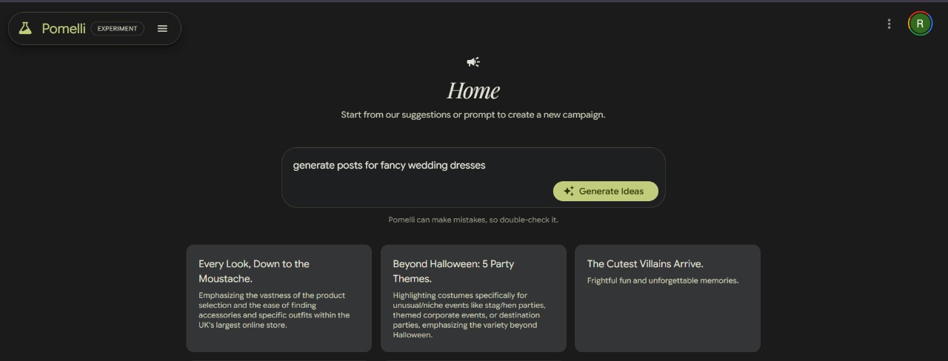
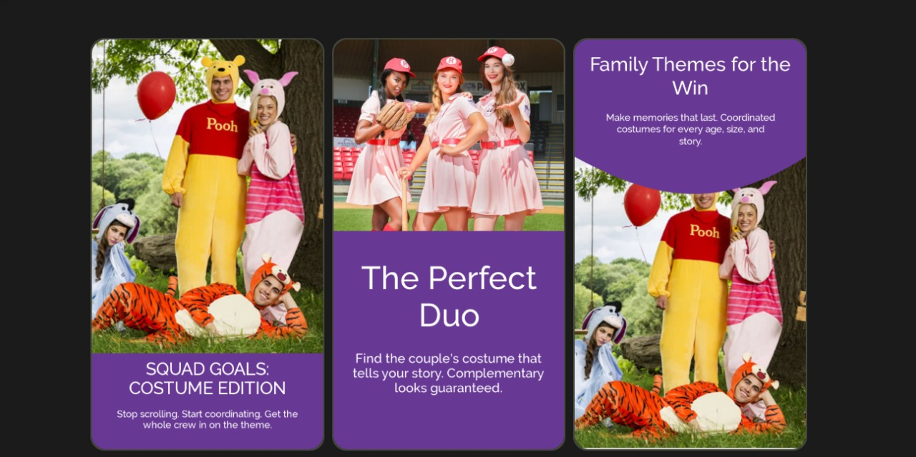
Competitive Analysis
Pomelli

Slide 8














Project Roadmap
Project Timeline
A phased approach to building the Cognitive Architecture, moving from theoretical design to a fully autonomous MVP.
Current
Phase 2
Week 10
Testing
Phase 1
Phase 3
Development
Launch
Key Milestones
Week 10-14
Week 15-22
Week 23-26
Requirements gathering and initial design
Development of core features
Testing and refinement

Slide 9





Q&A
Thank You & Questions?
Team Contact Information
s-abdulrahman.elattar@zewailcity.edu.eg
+201021780496
We welcome your feedback and insights
CSAI School | Zewail City of Science, Technology and Innovation

